Slide 1
Why software?

Slide 2
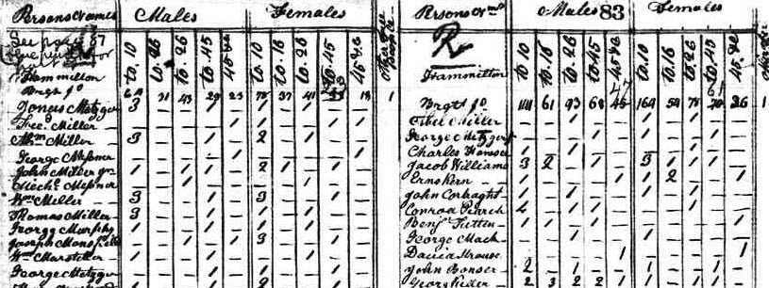
https://www.census.gov/data-tools/demo/race/images/1810.jpg

Slide 3
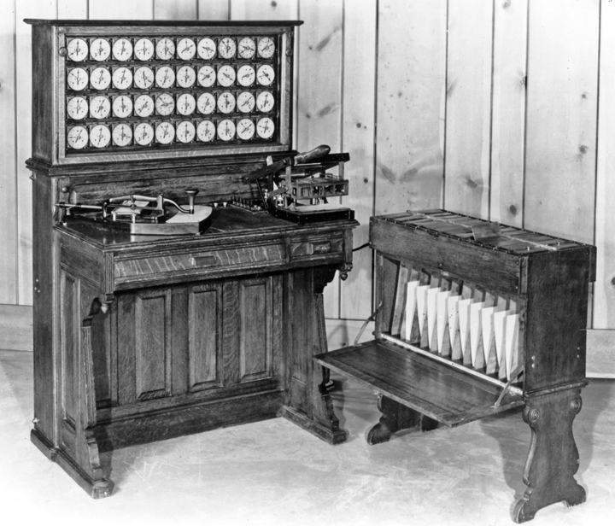
IBM, “The Punched Card Tabulator”

Slide 4
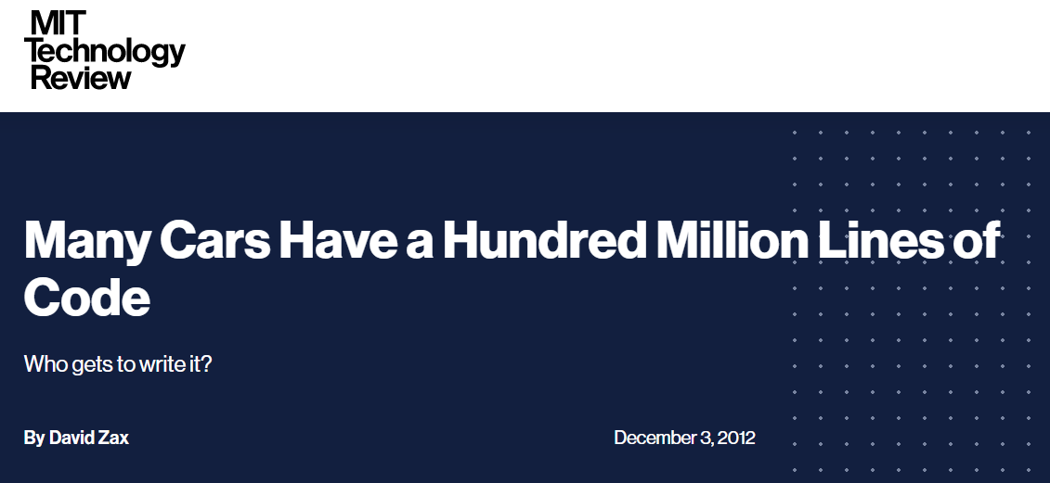
https://www.technologyreview.com/2012/12/03/181350/many-cars-have-a-hundred-million-lines-of-code/

Slide 5
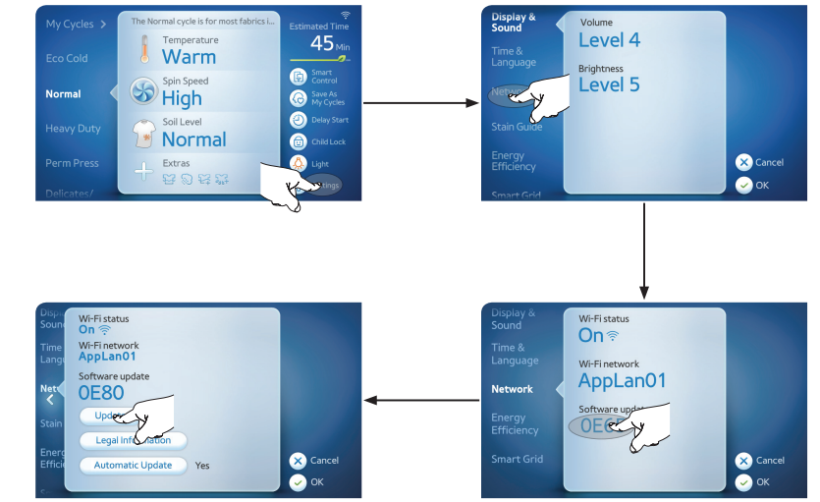
Samsung WF457ARGS user manual

Slide 6
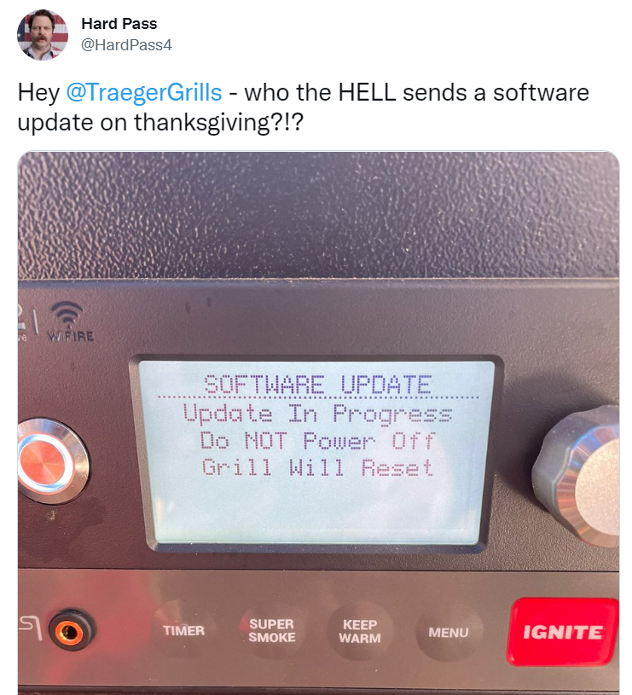
https://twitter.com/hardpass4/status/1463886150171566084

Slide 7
2002
1 | General Electric | Conglomerate | $372B
2 | Microsoft | Software | $327B
3 | ExxonMobil | Oil, gas | $300B
4 | Walmart | Retail | $273B
5 | Citigroup | Banking | $255B
6 | Pfizer | Health | $249B
7 | Intel Corporation | Hardware | $204B
8 | BP | Oil, gas | $201B
9 | Johnson & Johnson | Health | $198B
10 | Royal Dutch Shell | Oil, gas | $190B
Wikipedia, “List of public corporations by market capitalization”

Slide 8
2022
1 | Apple | Software, hardware | $2,850B
2 | Microsoft | Software | $2,311B
3 | Alphabet | Software | $1,846B
4 | Amazon | Retail, software | $1,659B
5 | Tesla | Cars, software | $1,114B
6 | Berkshire Hathaway | Conglomerate | $779B
7 | Nvidia | Hardware | $685B
8 | Meta | Software | $605B
9 | TSMC | Hardware | $541B
10 | UnitedHealth | Health | $480B
Wikipedia, “List of public corporations by market capitalization”

Slide 9

https://actu.epfl.ch/news/blue-brain-builds-neurons-with-mathematics/

Slide 10
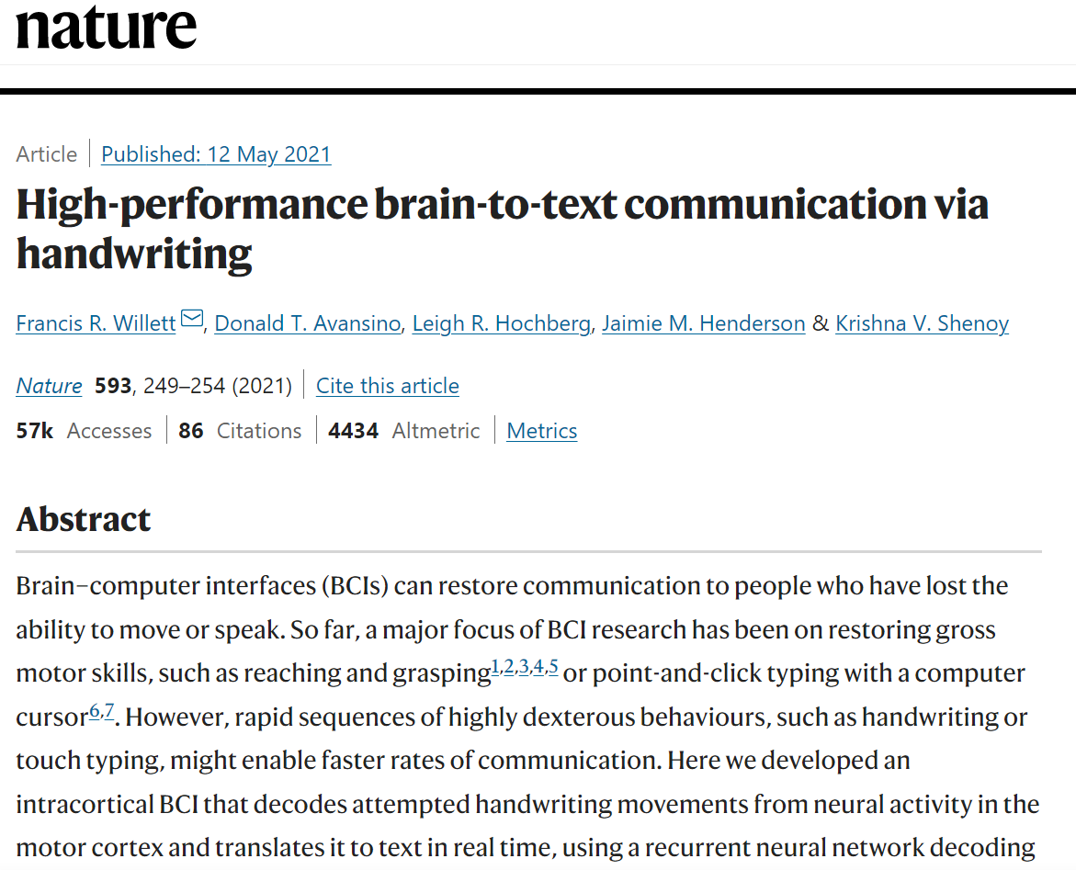
https://www.nature.com/articles/s41586-021-03506-2

Slide 11
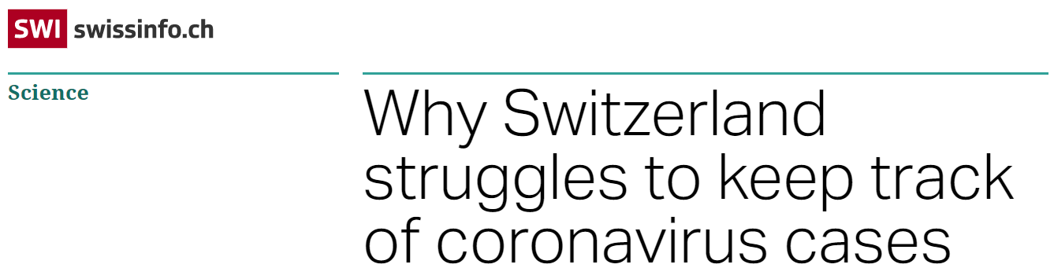
“[…] a byproduct of outdated methods. Cantons flag new cases on forms that they fill out and fax to the central government […]”
https://www.swissinfo.ch/eng/crunching-the-numbers_why-switzerland-struggles-to-keep-track-of-coronavirus-cases/45628604

Slide 12
Why software engineering?

Slide 13
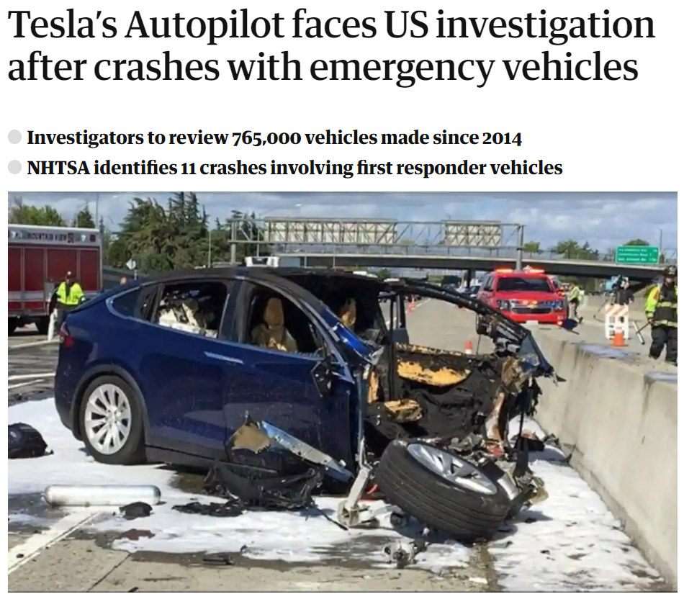
“[…] collisions with parked emergency vehicles.”
https://www.theguardian.com/technology/2021/aug/16/teslas-autopilot-us-investigation-crashes-emergency-vehicles

Slide 14
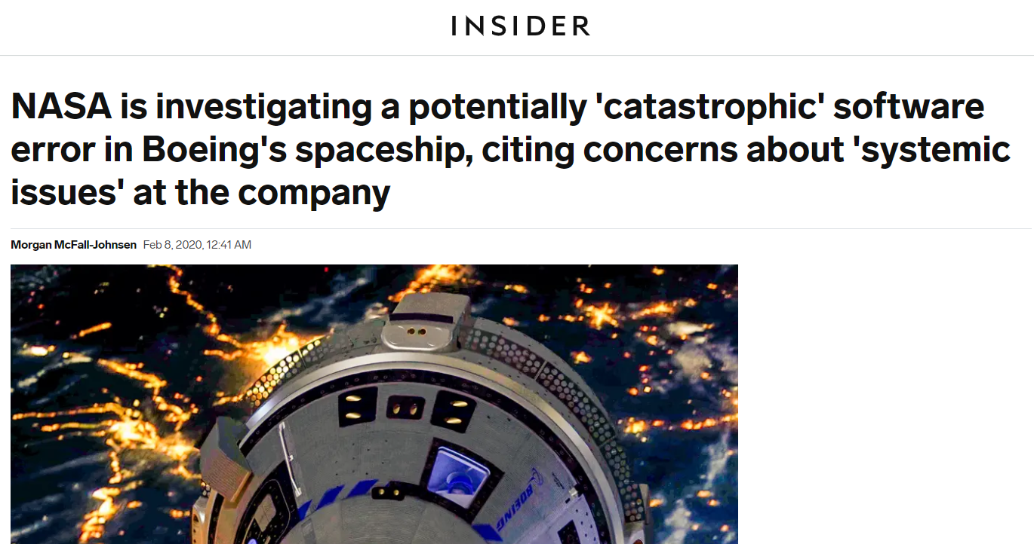
https://www.businessinsider.com/nasa-investigating-potentially-catastrophic-boeing-spaceship-error-2020-2

Slide 15
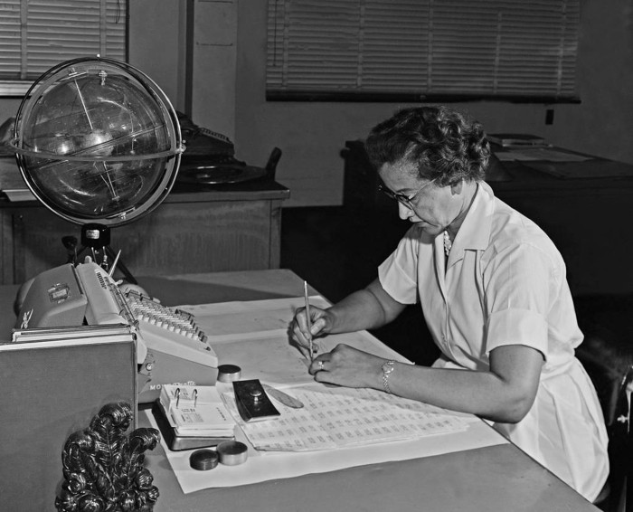
Katherine Johnson. Credit: NASA

Slide 16
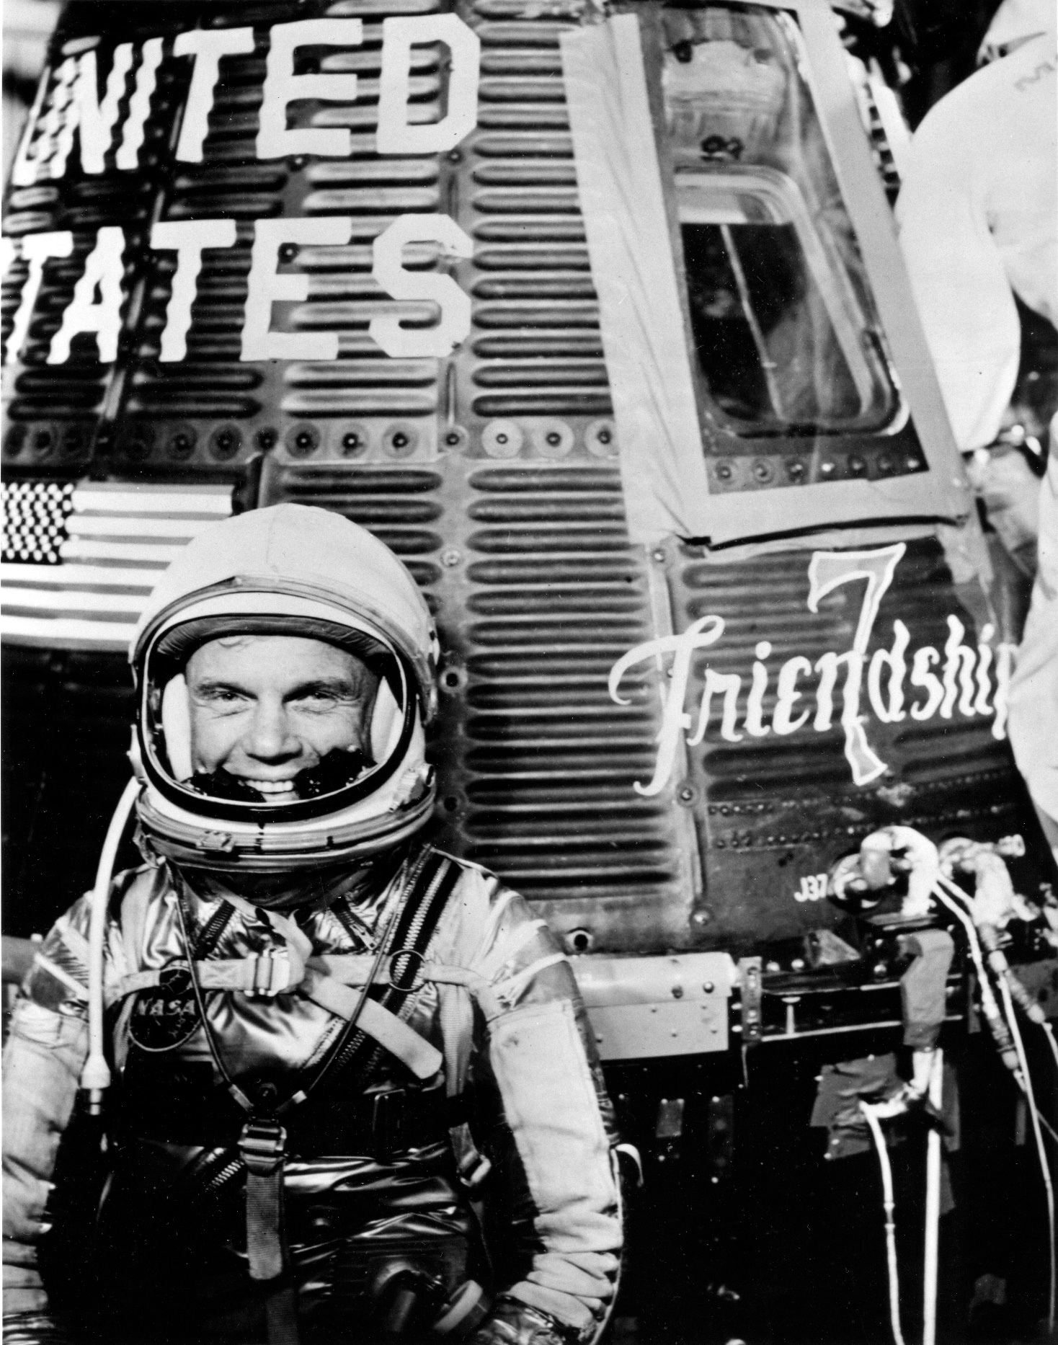
John H. Glenn Jr. Credit: NASA

Slide 17
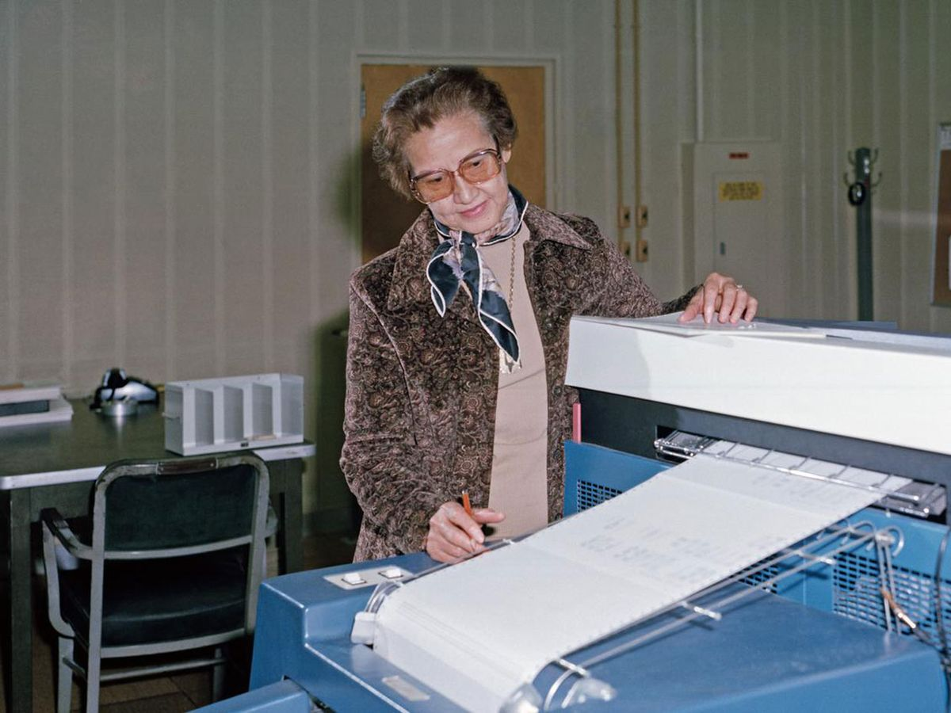
Katherine Johnson. Credit: NASA

Slide 18
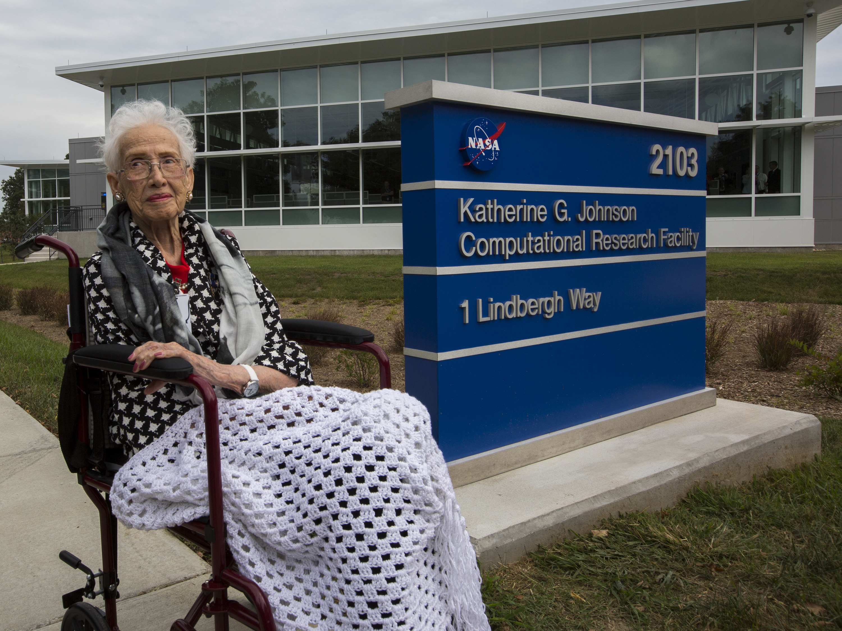
Credit: NASA

Slide 19
Complexity
if speed >= 100:
speed = 100
else:
speed = speed + 1

Slide 21
Lines of code
Apollo 11 ~150,000
Firefox ~10,000,000
Windows ~50,000,000
Estimates from publicly available data

Slide 22

Example
Alice, 9/10
Bob, 6/10
Carol, 7/10
...
Dear Alice,
Your grade is 9/10
…

Slide 23
Alice, 9/10
Bob, 6/10
Carol, 7/10
狄仁傑, 10/10

Slide 24
Alice, 9/10
Bob, 6/10
Carol, 7/10
Bob, Jr, 8/10

Slide 25


Dear Alice,
Your grade is …
…
Dear Bob,
Your grade is …
…

Slide 26


Dear Alice,
Your grade is …
…
Chère Alice,
Votre note est …
…
…

Slide 27





Slide 28


Slide 29
Windows ~50,000,000

Slide 30
Goal of this course

Slide 31




Slide 32

95%

Slide 33

…

Slide 34
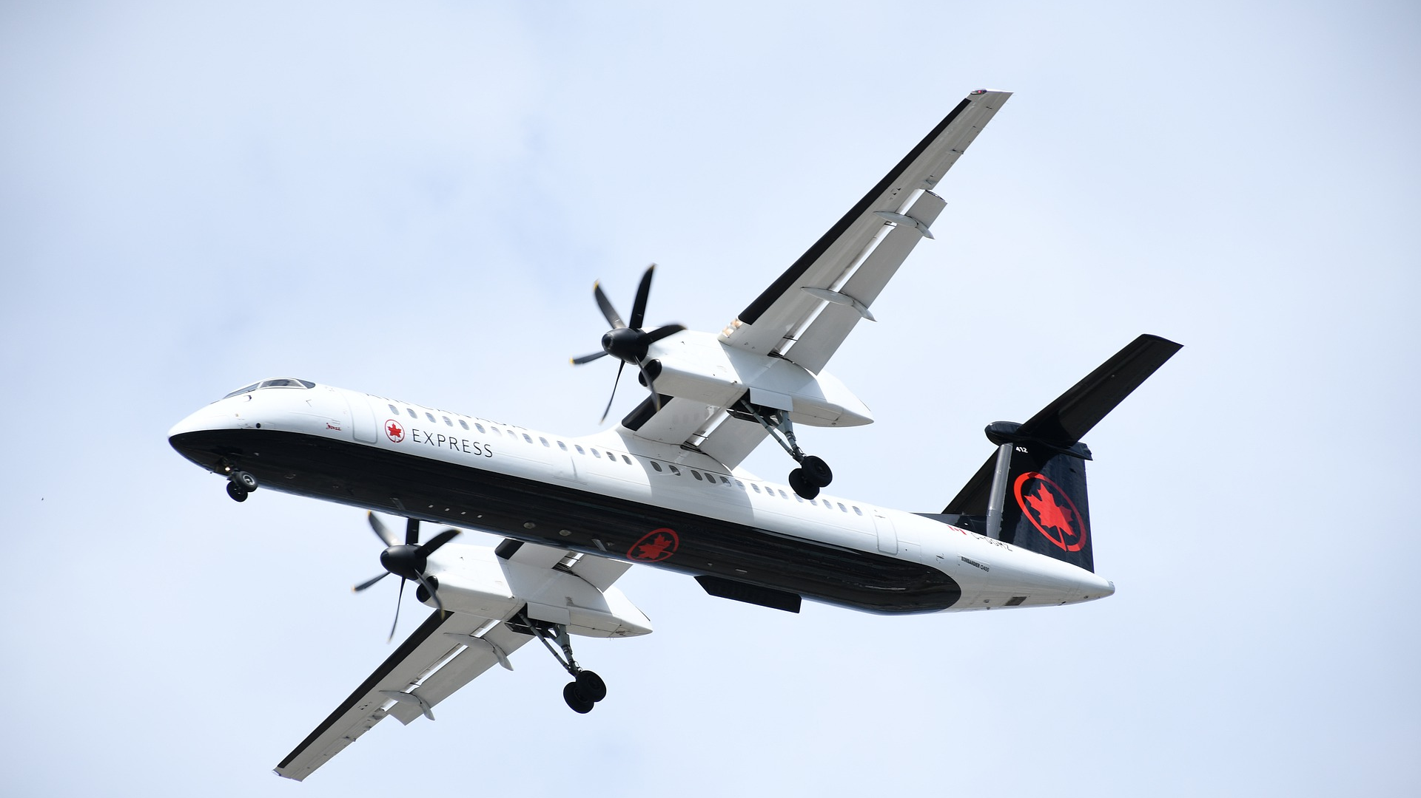

Slide 35
Writing code
≠
Developing software

Slide 36


Requirements
Design
Code
Evolution

Slide 37






Ops
Perf.
Security
Code
Test
Debug
Teamwork

Slide 38
Modern tools

Slide 39
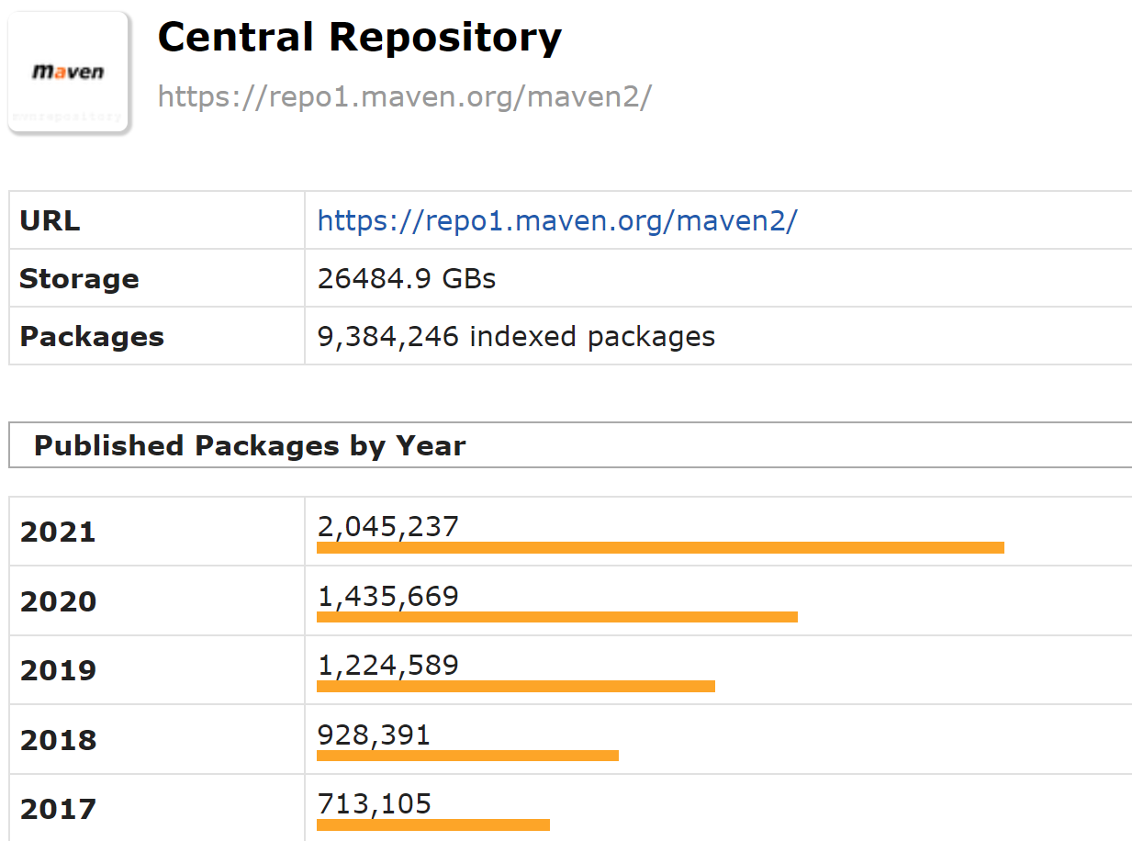
https://mvnrepository.com/repos/central

Slide 40
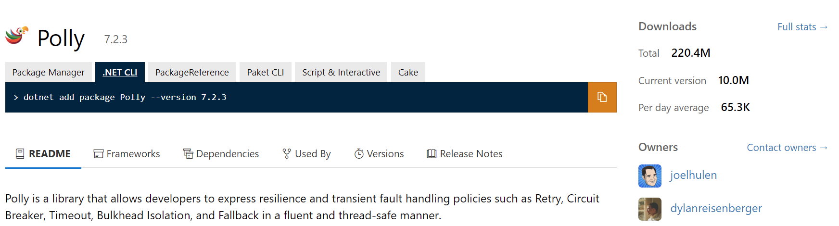
https://www.nuget.org/packages/Polly

Slide 41
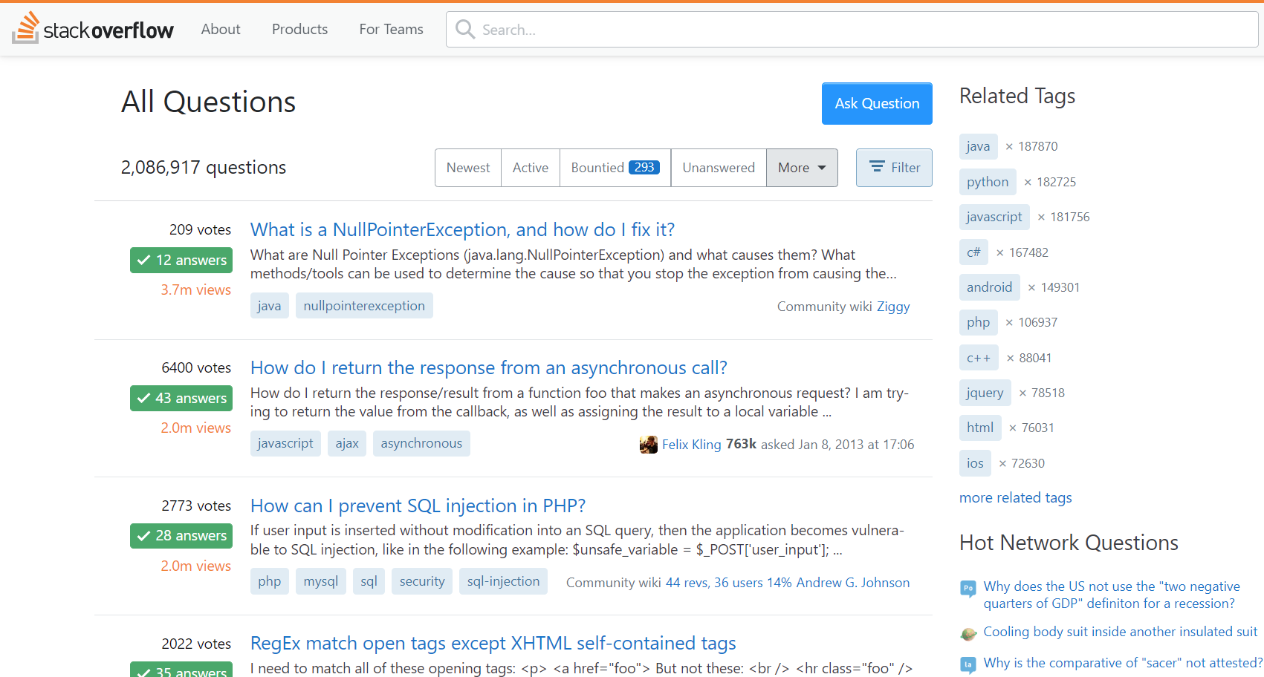

Slide 42
Exercise: PHP
class Context {
protected $config;
public function getConfig($key) {
$cnf = $this->config;
return $cnf::getConfig($key);
}
}
syntax error, unexpected T_PAAMAYIM_NEKUDOTAYIM
Notes:
2min

Slide 43
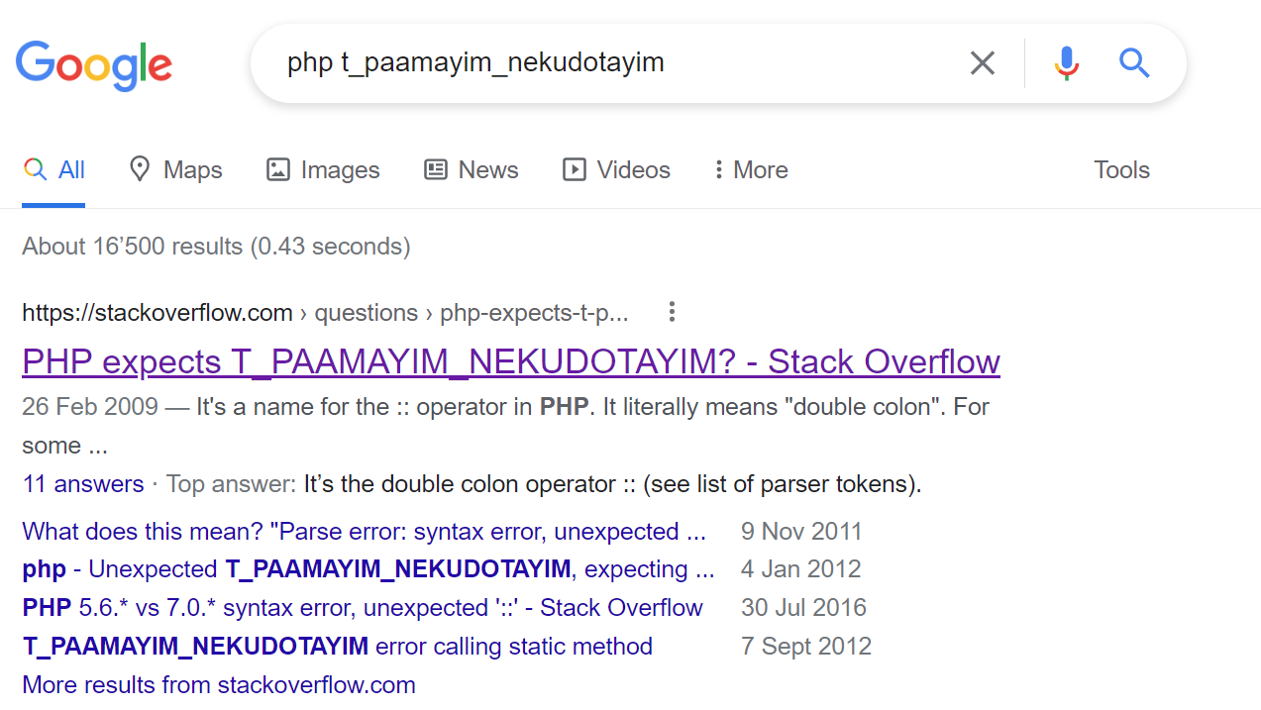

Slide 44
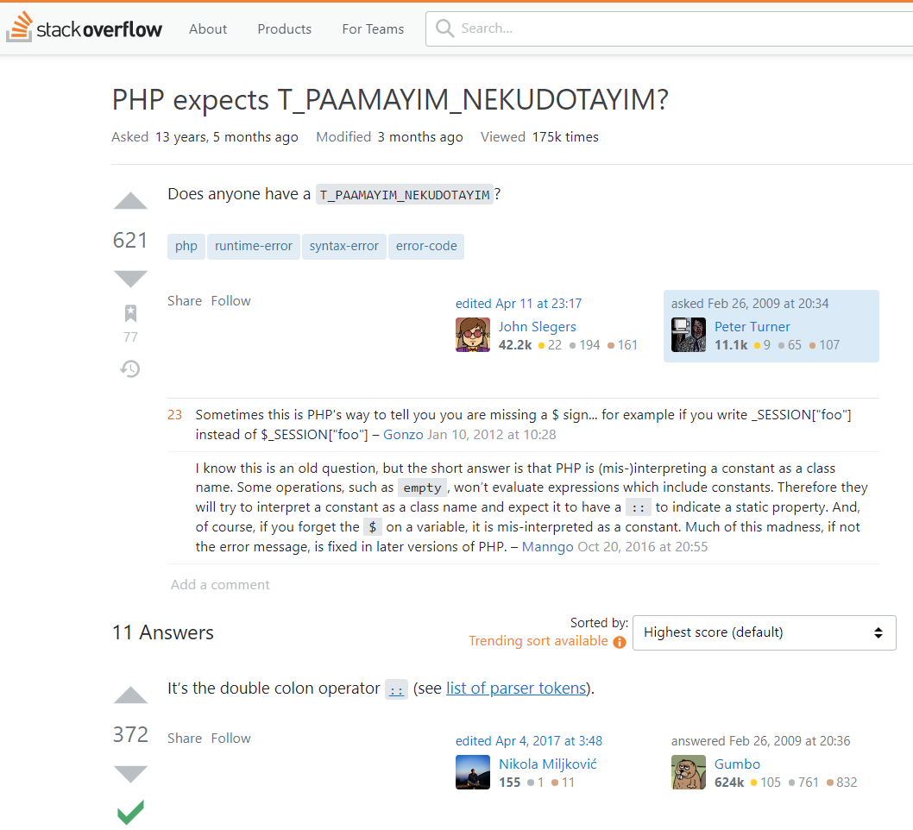
https://stackoverflow.com/questions/592322/php-expects-t-paamayim-nekudotayim

Slide 45
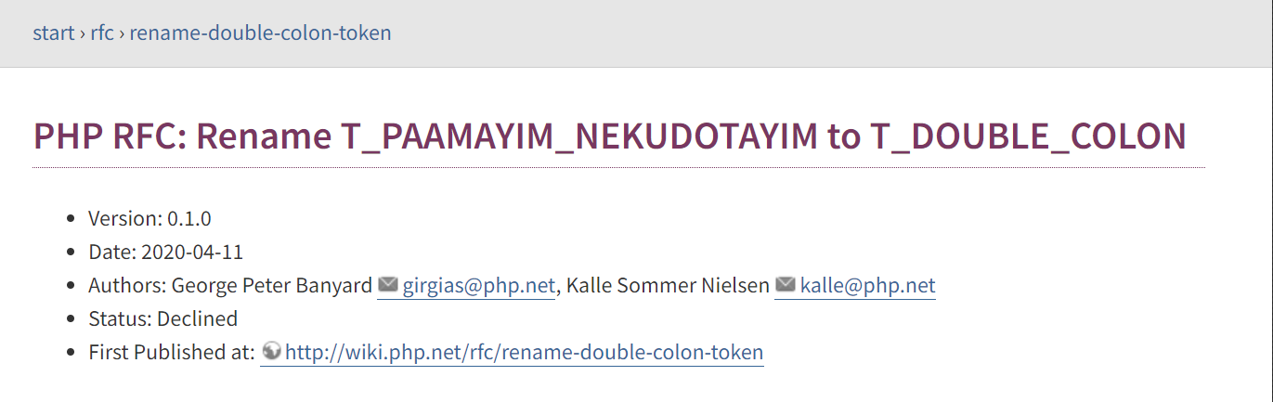
https://wiki.php.net/rfc/rename-double-colon-token

Slide 46
Exercise: Windows
“A customer using our Win32 app is getting the error code 39…”
Notes:
2min

Slide 47
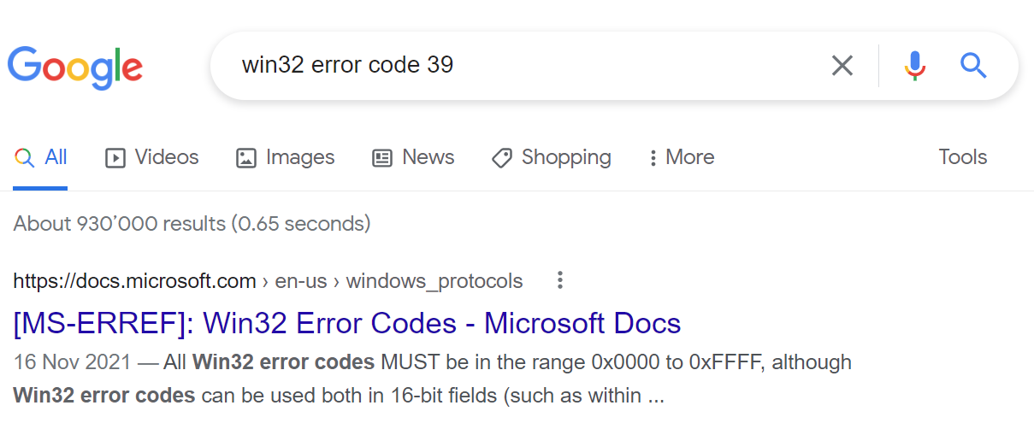

Slide 48
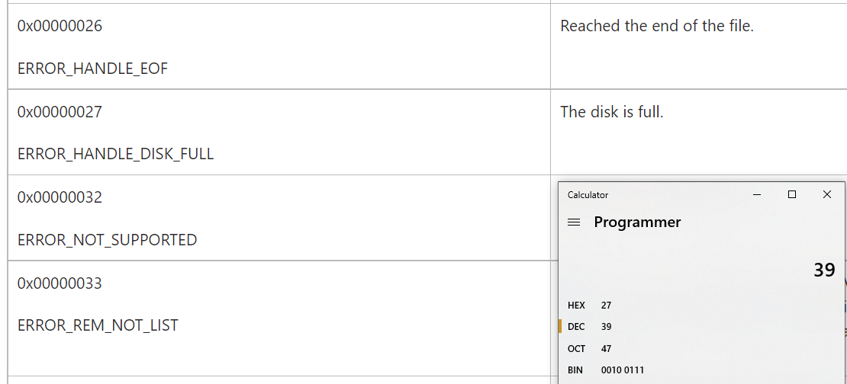
https://docs.microsoft.com/en-us/openspecs/windows_protocols/ms-erref/18d8fbe8-a967-4f1c-ae50-99ca8e491d2d

Slide 49
Course method

Slide 50


ZZZ

Slide 51


Slide 52

Exercises
Exam

